Slide 1
Beginning Tax Return - TaxWise Main Info Screen
Pub 4012 Main Information Screen section
NJ 1040 Pages 1 and 2
Notes:
1

Slide 2
TW – Main Information Screen Basic Taxpayer Information
Once screening and interviewing is done, counselors can start the tax return in TaxWise
Start a New Return by entering SS # of first taxpayer
If carry-forward data is available, TW will tell you
Generally, all data entered on Main Info is automatically populated on NJ 1040 pages 1 & 2
Enter (or verify & get red out if carry-forward data) on Main Information :
Name and Social Security Numbers of taxpayer and spouse
Either spouse can be listed first on return (convention says male first)
Mailing address
Phone number
Birthdates
Occupations

Slide 3
TW Main Information Screen Enter Taxpayer & Spouse Name & SS#s
Notes:
Normally it doesn’t matter which spouse is listed first on return. However, when one spouse is deceased, surviving spouse’s name must be first and return must be listed under Social Security # of surviving spouse
Combination of both names on return cannot exceed 35 characters
Usually not a problem since only first name of spouse is listed, unless different than taxpayer last name
Can be a problem with different last names or hyphenated names
Truncate names according to instructions on Pub 4012, Page C-17 or paper file Federal return (can still e-file NJ return)
3

Slide 4
TW Main Information Screen Enter Phone Number, Birth Dates, Occupations
(cont’d)
Notes:
When you enter birth date, TW automatically calculates age
4

Slide 5
Main Information Data May Need Manual Update on NJ 1040
Most of the information from the Main Information screen is automatically updated on the NJ return
There are a few situations which require additional manual entry on NJ TW screens:
NJ 1040 Page 1:
County/Municipality code
Check Boxes as needed for:
Attached death certificate
Name change
Address change
Attached Federal Extension
Notes:
The assumption here is that special NJ treatment fields AND the additional manual entries or adjustments are made as part of handling federal data entry
This is not required by TW – entries can almost always be made in any order
Instructions for special fields and adjustments are given in the slides covering both federal and NJ entry for each topic
Many experienced preparers are used to not doing anything on the NJ return screens until the federal screens are done
There is nothing “wrong” with this, but we encourage (wherever possible) that all entry for a tax form / tax issue be done at the same time to facilitate effective interviewing and to minimize needing to remember (and often forgetting) to do something later

Slide 6
NJ 1040 Page 1 County/Municipality Code
Determine County/Municipality codes from:
NJ 1040 instruction booklet
County/Municipality look-up tool on TaxPrep4Free.org under Preparer Tools in right-hand column
If place where client lives is not listed, enter code where property taxes are paid
Notes:
Demonstrate look-up tool for Municipality code on TaxPrep4Free.org

Slide 7
TW NJ County/Municipality Code – NJ 1040 Page 1

Slide 8
TW NJ Check Boxes That Apply NJ 1040 Page 1

Slide 9
Filing a Return for a Deceased Taxpayer
Pub 4012 Tab K
Deceased taxpayer will be identified as a checked box on Intake/Interview form Page 1, Part II- Widowed
Deceased Taxpayer’s return
Final personal income tax return must be filed
Estate tax return (Form 1041) may need to be filed Out of Scope
Personal tax return can be filed by:
Surviving spouse
Personal representative – Executor of estate or anyone who is in charge of decedent’s property
Court appointed representative
Notes:
9

Slide 10
Filing a Return for a Deceased Taxpayer
Pub 559
(cont’d)
Return filed by surviving spouse
Surviving spouse’s name must be first AND
Return must be listed under Social Security # of surviving spouse
You can start a return under deceased's name to get carry-forward data and then change name order of names on Main Info
Should include income earned by decedent up to date of death plus full-year income for surviving spouse
Add “Signing as surviving spouse” next to signature
Return filed by personal representative (executor or administrator of the decedent’s estate, as appointed or certified by the court)
Only include income & deductions up to date of death
File Form 56 Notice Concerning Fiduciary Relationship to notify IRS of contact for correspondence
If filing a current year tax return and refund is due, attach copy of Court Appointment Certificate
If filing an amended return, attach a copy of Court Appointment Certificate and paper Form 1310 Statement of Person Claiming Refund Due a Deceased Taxpayer via mail
Sign return followed by “Personal Representative”
Return filed by anyone else
If refund is due, mail in paper Form 1310
Notes:
10

Slide 11
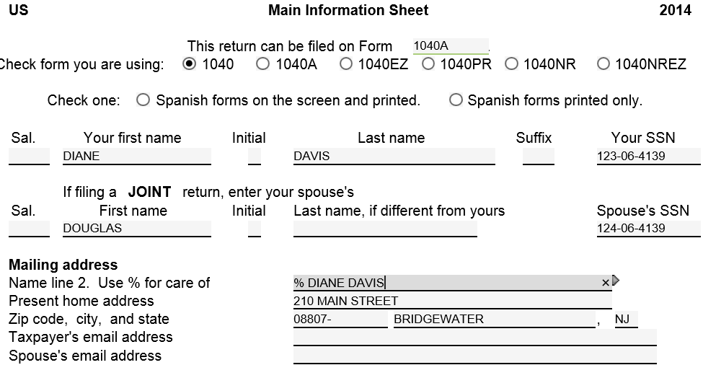
TW Main Information Screen Final Joint Return Deceased Taxpayer – Filed by Surviving Spouse
Surviving spouse
Deceased spouse
% space surviving spouse name or Personal Representative name
Combination of name on Name line 2 + surviving spouse name cannot exceed 30 characters or will generate e-file error. > 30 characters need to truncate names or paper file Federal, not NJ
Notes:
Name Line 2 on Main Information screen must say % (followed by space) name of surviving spouse
Combination of name on Name line 2 plus surviving spouse name cannot exceed 30 characters
Will generate an error code when ERO tries to e-file (not a diagnostic error)
If names > 30 characters, can truncate names as shown on Pub 4012 Page C-17 or paper file Federal return. NJ return can still be e-filed
11

Slide 12
TW Main Information Screen Deceased Taxpayer – Date of Death and Who is Filing Tax Return
Enter date of death
TW checks who is filing return
Notes:
Enter date of death under Taxpayer Information section of Main Information screen
TW will automatically check box that indicates who is filing return on behalf of deceased spouse
12

Slide 13
TW Printed 1040 Return Of Deceased Taxpayer
TW populates on printed 1040
Deceased notice will not appear on TW 1040 screen, only
on printed return
Notes:
TW will populate “Deceased,” name, date of death on top of printed 1040 page 1
Will not appear on TW 1040 screen
13

Slide 14
Main Information Screen for Deceased Taxpayer – TW Tips
Return should be started under SS # of surviving spouse (primary taxpayer). Deceased listed as Spouse
Regardless of how prior year return was filed
Name Line 2 on Main Information screen must say % (followed by space) name of surviving spouse or personal representative
Enter date of death under Taxpayer Information section, & TW will automatically check box to indicate who is filing return
TW will populate “Deceased,” name, date of death on top of printed 1040 page 1
Will not appear on TW 1040 screen
Notes:
14

Slide 15
Main Information Screen for Deceased Taxpayer – TW Tips
(cont’d)
Name on Name line 2 plus surviving spouse name cannot exceed 30 characters in TW
Will cause e-file error code (not Diagnostics error)
Combined names > 30 characters
Truncate names as suggested on Pub 4012, Page C-17 OR
Paper file Federal return; can still e-file NJ return
Notes:
15

Slide 16
TW - Main Information Screen Taxpayer Information Section
Check off appropriate boxes, where applicable:
Blind (see specific rules in Personal Exemption Section)
Totally and Permanently Disabled (see specific rules in Personal Exemption Section)

Slide 17
TW Main Information Screen Entries for Blind, Disabled
(cont’d)
Notes:
Check box to show disabled and/or blind
17

Slide 18
TW - Main Information Screen Taxpayer Information Section
(cont’d)
Check appropriate box if taxpayer/spouse wishes to designate $3 for Presidential Election Campaign
From Intake/Interview Sheet Page 2
Checking Yes box does not cost taxpayer. There is no impact to client’s return

Slide 19
TW Main Information Screen Entry for Presidential Campaign
(cont’d)
Check if taxpayer/spouse wishes to designate $3 to
Presidential Election Campaign
Notes:
Answer question on Presidential Election Campaign based on question 1 in Part VII of Page 3 of Intake/Interview Sheet. Taxpayer & spouse can choose to donate individually
19

Slide 20
NJ 1040 Page 2 Gubernatorial Elections Fund
(cont’d)
Manual entry of taxpayer’s/spouse’s choice to designate $1 to Gubernatorial Elections Fund
Answering Yes to this question does not impact the tax return or cost the taxpayer anything
NJ return requires Yes or No answer
Federal return only requires check if answer is Yes, nothing for No

Slide 21
TW NJ 1040 Page 2

Slide 22
TW -Main Information Screen Filing Status and Exemptions Section
Filing status (covered in later module)
Question relating to whether you can be claimed on another person’s return
Dependent/Nondependent information:
Names
SS #s
Birth Dates (TaxWise calculates age)
Relationship to taxpayer (Drop down menu)
Months in home (Drop down menu) – enter 12 months for dependents born, adopted or died in current tax year
Dependent/Nondependent code (Drop down menu)
Check Dependent Care (DC) box, if applicable
Check EIC box
TW checks CTC box, if applicable
Notes:
Months in home field
Enter “MX” if dependent lives in Mexico
Enter “CN” if dependent lives in Canada

Slide 23
TW Main Information Screen Enter Dependents/NonDependents
(cont’d)
Notes:
TaxWise populates Exemptions boxes based on what was entered at top of Main Info screen
There is only space for 4 dependents on Main Info screen. Must enter rest of dependent info on Additional Dependents screen (see next slide)
Drop down menus for Relationship to You, Months in Home, and Code boxes
Code box used to indicate dependency status
Months in Home box used to indicate how long person lived with taxpayer during tax year
Check DC box if you incurred dependent care expenses during year
Check Earned Income Credit (EIC) box for every dependent. TW will determine if person is eligible based on answers to questions later
TaxWise automatically determines if child is eligible for Child Tax Credit (CTC) and checks CTC box as appropriate. Counselor does nothing
23

Slide 24
TW Additional Dependents Screen For More than 4 Dependents
Link from 1040 Page 1 Dependents Section, not from Main Info Screen
TW populates 1st 4 dependents from Main Info
Enter info for dependents over 4
Notes:
If taxpayer has more than 4 dependents:
Enter first 4 dependents on Main Info screen, starting with the youngest
Nondependents & children who are qualifying children for EIC must be entered on Main Info screen in order to process correctly
Go to 1040 Page 1 (not Main Info screen) & link from any field in dependents section to Addl. Deps – Form 1040 Line 6C screen
TW transfers info for first 4 dependents from Main Info screen
List info for remaining dependents
IMPORTANT: Once Additional Dependents form is created, changes to dependent info on Main Info screen do not flow through to Additional Dependents form
Make same change twice – once on Main Info screen & once on Additional Dependents screen
If dependent line is not complete on Main Info screen (e.g. – a field is not completed), that dependent will not transfer to Additional Dependents screen
24

Slide 25
Filing Status and Exemptions Manual Updates on NJ 1040 Page 2
Lines 1-5 – Filing Status
Calculated from Main Info
Adjustments for Civil Union are Out of Scope
Lines 6-12 – Exemptions
Calculated from Main Info
Manual entry on Line 6 if claiming Domestic Partner
Manual entry on Line 11 - Dependents attending colleges
Line 13 – Dependents’ information
Calculated from Main Info for Code 1, 2, 3
Manual entry via NJ Dep Wkt (covered in NJ module):
Checkbox for dependents without Health Insurance
Addition of Code 0 dependents involved in EIC calculation

Slide 26
TW NJ 1040 Page 2 Dependents Under 22 Attending College
Notes:
Extra NJ exemption for college students under age 22

Slide 27
Identity Theft
Pub 4012 Tab P
Identity Theft is the fraudulent acquisition of a person’s private identifying information, usually for financial gain
IRS sends notices to known taxpayer victims (or potential victims)
Letter includes 6-digit Identity Theft Protection PIN for filing return (reissued each year)
Counselor should routinely ask taxpayer about this

Slide 28
TW - Main Information Screen PIN Sections
Taxpayer & Spouse PIN
Must fill in with any 5 digits (except 00000)
Identity Theft PIN
If applicable enter on Main Info screen or return will reject
Follow 4012 Tab P instructions
Contact ID Theft hotline if needed
If this does not apply to taxpayer, do nothing

Slide 29
Taxpayer/Spouse & Identity Theft PINs - TW Main Information Screen
(cont’d)
Taxpayer’s/Spouse’s PIN
Identity theft PIN
Notes:
Enter any Taxpayer’s & Spouse’s PINs; will not be pre-populated
29

Slide 30
TW- Update Prep Use Screen
After updating Main Info, go to Prep Use screen on Forms Tree.
Answer questions, input Counselor initials
Quality Reviewer initials entered after QR is complete
Notes:
Quality Reviewer initials should not be entered until after quality review is completed
Can use drop down menus to answer questions 11 & 12 or can type in answer

Slide 31
TW-Update Prep Use Screen
The bottom of prep use screen has a place to enter Taxpayer Reminders
The first time the return is opened the following year with carry-forward data, these reminders will pop up to notify the counselor
Notes:
We put a reminder on Prep Use page to “See Taxpayer Diary” because that message will pop up with carry-forward data. Then counselor will know enough to look in the Taxpayer Diary to get details. Otherwise, counselor may not think to look in the Taxpayer Diary

Slide 32
TW – Use of Taxpayer Diary
Use Taxpayer Diary to record information that would not otherwise appear in taxpayer’s return
Click on Taxpayer Diary icon at top of screen
Each return has a separate page
TW automatically records counselor’s name, date, time
Must save entries in Taxpayer Diary; not automatic
Enter “See Taxpayer Diary” in notes section of Prep Use page to alert next year’s counselor of Diary entry
Taxpayer Diary entries will appear every year thereafter when carry-forward data is brought up
Notes:
32
Remind students to save any comments recorded in Diary. TW normally automatically saves things

Slide 33
TW- Taxpayer Diary
Taxpayer Diary Icon
TW populates counselor’s name, date & time of entry
Counselor enters notes
Be sure to save

